Slide 1
9
10
13
VERNIER SCALE
12
MAIN SCALE
11
AXIS OF THE TELESCOPE
7
1
3
6
2
θ
AXIS OF THE COLLIMATOR
18
4
5
8
19
21
17
15
14
16
20

Slide 2
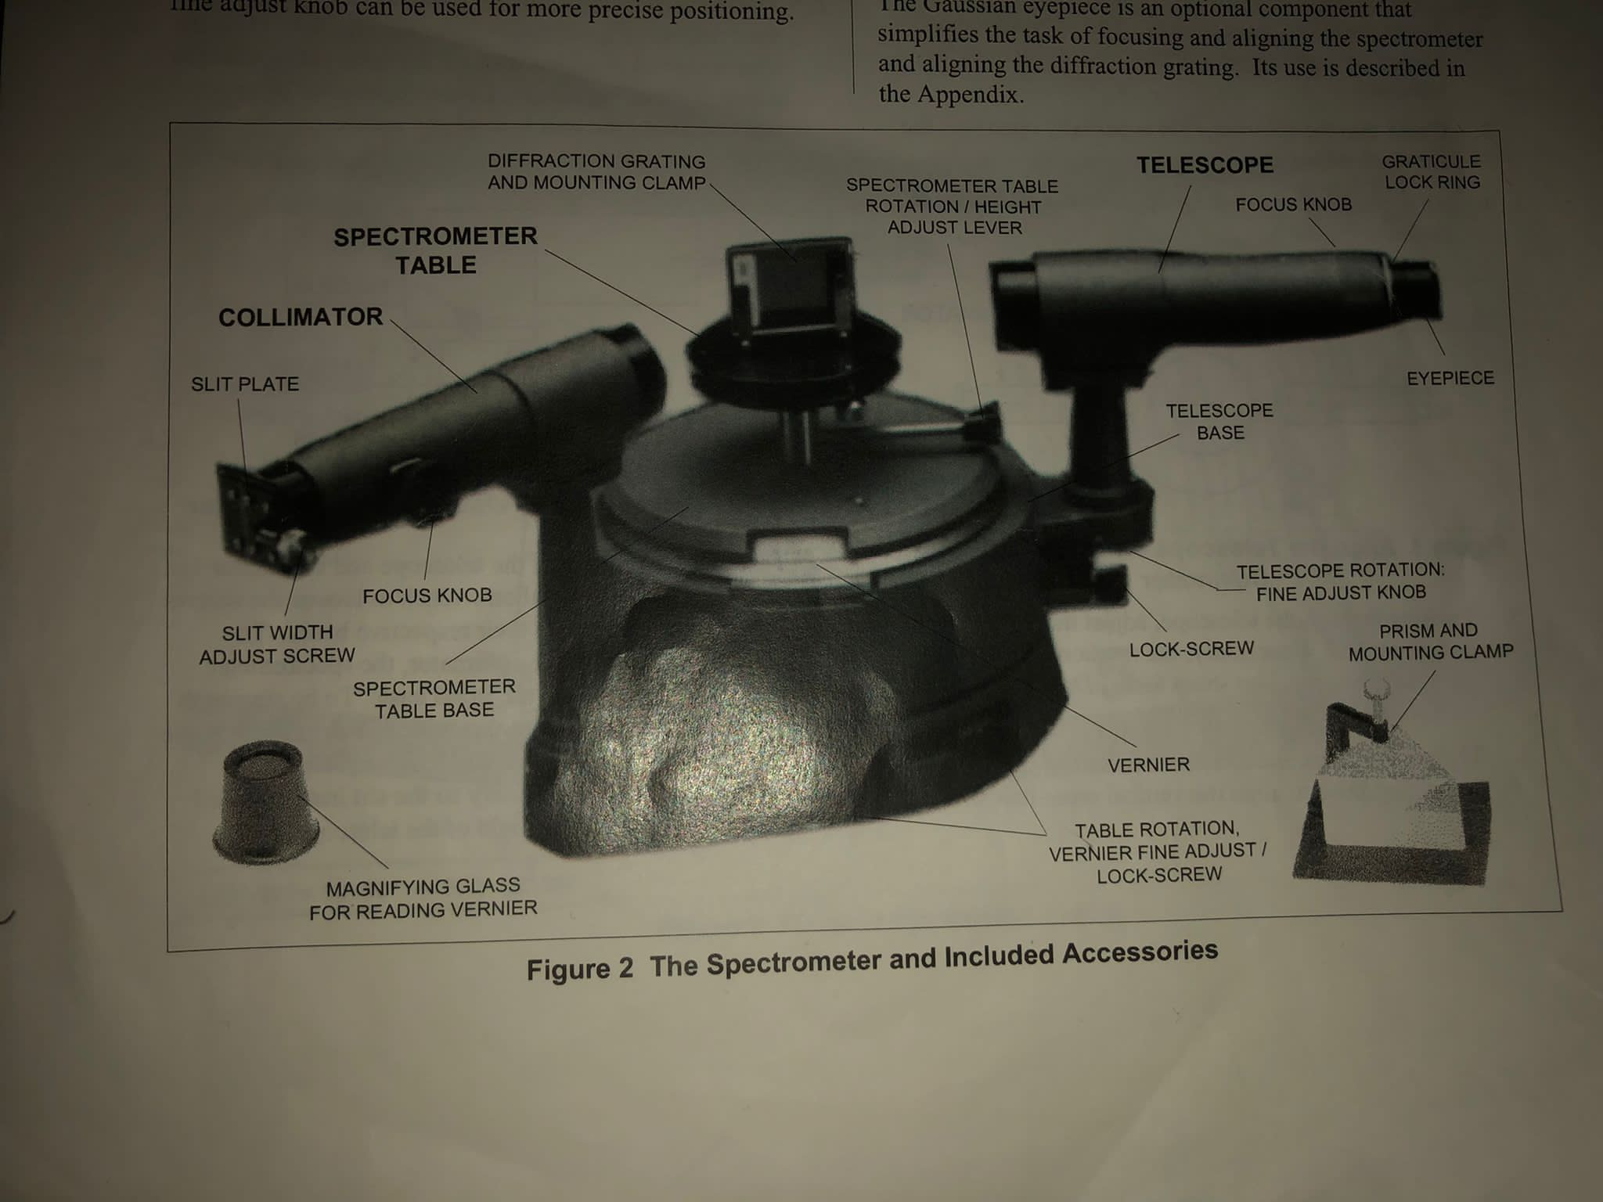
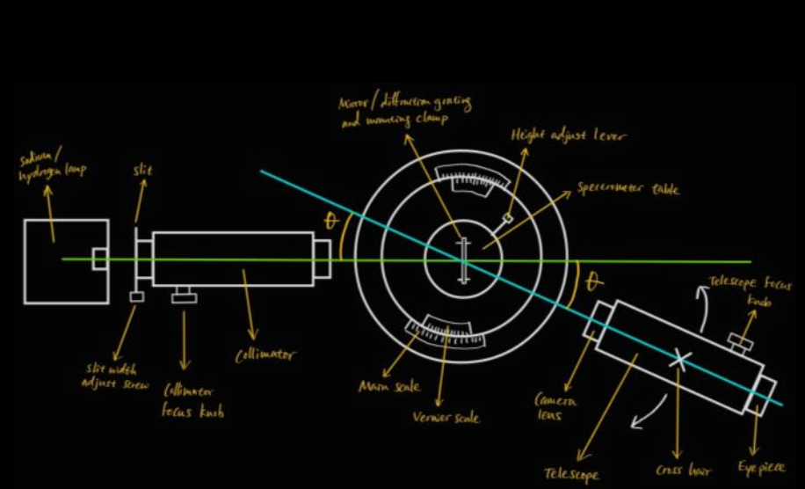

Slide 3
VERNIER SCALE
± 1’
30
20
10
0
140
120
130
MAIN SCALE ± ½⁰

